Slide 1
Module 1

Slide 2

SURFACE AREAS
AND VOLUMES
CUBOID - Introduction
Notes:
School
2

Slide 3
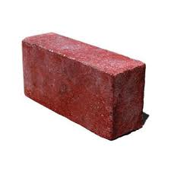
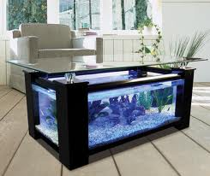
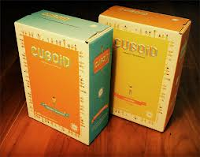
CUBOID
Examples :
Let us see few examples
of cuboid
Brick
Boxes
Fish Aquarium

Slide 4
CUBOID
A cuboid has six faces.
1
4
1
Two horizontal faces.
Four vertical faces.
6
2
A cuboid has eight corners.
1
4
3
3
h
5
A cuboid has three dimensions,
2
which are length (l ),
breadth (b) and height (h)
2
b
l
Let us see geometrical
figure of cuboid

Slide 5
Formulae
Vertical Surface Area
= 2 (l + b) h
Total Surface Area =
2 (lb + bh + lh)
Area of the shaded face
= l × h
Let us first understand formula for vertical surface area of a cuboid
Area of the shaded face
= b × h
Let us now understand the formula for total surface area of cuboid
h
Area of the shaded face
= b × h
Area of the shaded face
= l × h
Area of the shaded face
= l × b
Let us see formulae
related to cuboid
A cuboid has 2 base faces
b
Area of rectangle = Product of adjacent sides
l
Total surface area
=
Vertical surface
+
Area of 2 base faces
Vertical surface area
=
Sum of areas of 4 vertical surfaces
=
2 (l + b) h
+ 2
(lb)
=
lh
+
lh
+
bh
+
bh
=
2lh
+ 2bh
+ 2lb
=
2lh
+
2bh
=
2
=
(lb + bh + lh)
2
h
(l + b)
=
2
(l + b)h

Slide 6
Formulae
Continuing the process
if we place ‘h’ such rectangles
on one another,
Let us place another
rectangle of same
length and breadth
on it
Let us place another
rectangle of same
length and breadth
on them
What is the Area
of rectangular
base ?
h
What is the Area
two rectangles ?
Volume of cuboid is the
capacity of the cuboid
Let us consider the base
of the cuboid
What is the Area of
3 rectangular bases ?
What is the figure so
formed ?
∴ Volume of cuboid =
l × b
3 × l × b
2 × l × b
h × l × b
Cuboid
l × b × h
h
What is the space
occupied ?
b
Volume of cuboid =
l
l × b × h
l × b
2 × l × b
3 × l × b
h × l × b

Slide 7
Module 2

Slide 8
SURFACE AREAS
AND VOLUMES
Sums based on Cuboid
Notes:
School
8

Slide 9
Q. The dimensions of a cuboid in cm are 16 × 14 × 20.
Find its total surface area.
Sol.
For given cuboid,
What is formula for finding total surface area of cuboid ?
length (l ) = 16 cm
2(lb+bh+lh)
breadth (b) = 14 cm
height (h) = 20 cm
Total surface area of cuboid
= 2(lb + bh + lh)
= 2
(16 × 14
+ 14 × 20
+ 16 × 20)
= 2
(224
+ 280
+ 320)
= 2
(824)
= 1648 cm²
∴ Total surface area of the cuboid is 1648 cm².

Slide 10
Volume
Q. The cuboid water tank has length 2 m, breadth 1.6 m and height 1.8 m.
Find the capacity of the tank in litres.
Sol.
length (l ) = 2 m
breadth (b) = 1.6 m
We know that,
1 m³ = 1000 litres
height (h) = 1.8 m
Volume of cuboid water tank
= l × b × h
What is formula for finding volume of cuboid ?
= 2
× 1.6
× 1.8
l × b × h
= 5.76 m³
= 5.76
× 1000 litres
[1m³ = 1000 litres]
= 5760 litres
∴ Volume of cuboid water tank is 5760 litres.

Slide 11
Module 3

Slide 12
SURFACE AREAS
AND VOLUMES
Sum based on Cuboid
Notes:
School
12

Slide 13
Q. A fish tank is in the form of a cuboid whose external measures are
80 cm × 40 cm × 30 cm. The base, side faces and back face are to be
covered with a coloured paper. Find the area of the paper needed.
Area of the paper needed =
Area of base +
Area of two side faces +
Area of back face
Sol.
For cuboid fish tank,
length (l ) = 80 cm
breadth (b) = 40 cm
lh
h
bh
bh
height (h) = 30 cm
l
Area of base
= l × b
lb
b
= 80
× 40
l
What is the formula to find area of base ?
= 3200 cm²
Area of two side faces =
2 × b × h
= 2
× 40
× 30
= 2400 cm²
Area of back face
= l × h
What is the formula to find area of back face ?
What is the formula to find area of a side face ?
= 80
× 30
= 2400 cm²

Slide 14
Q. A fish tank is in the form of a cuboid whose external measures are
80 cm × 40 cm × 30 cm. The base, side faces and back face are to be
covered with a coloured paper. Find the area of the paper needed.
Area of the paper needed =
Area of base +
Area of two side faces +
Area of back face
Sol.
Area of the paper needed
h
= Area of base
+ Area of two side faces
+ Area of back face
b
l
= 3200
+ 2400
+ 2400
= 8000 cm²
Area of base
= 3200 cm²
∴ Area of the paper needed is 8000 cm².
Area of two side faces
= 2400 cm²
Area of back face
= 2400 cm²

Slide 15
Module 4

Slide 16
SURFACE AREAS
AND VOLUMES
CUBE – Introduction
Notes:
School
16

Slide 17
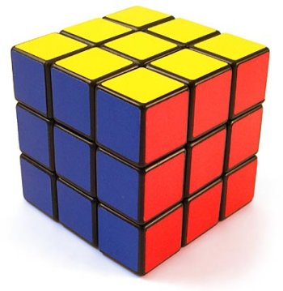
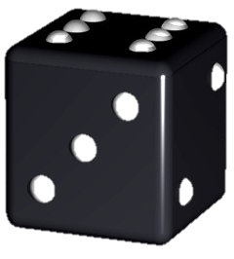
CUBE
Cube is a special type of cuboid in which all surfaces are square in shape
Let us see few examples
of cube
Rubix cube
Dice

Slide 18
CUBE
A cube has six faces.
1
6
Let us see geometrical
figure of cube
3
4
5
2
All the sides of a cube
are equal
Let ‘l’ be the length of
each side
l

Slide 19
Formulae
1. Vertical surface area =
4l
²
2. Total surface area =
6l
²
For cube,
l = b = h
3. Volume of cube =
l
Area of shaded face
= l ²
Let us see formulae
related to cube
Area of shaded face
= l ²
³
A cube has four
vertical square faces
Area of square = (Side)²
Volume of a cube is the
capacity of the cube
l
Volume of a cube =
Total surface area =
6 ×
Area of a square face
l × b × h
Vertical surface area =
4 ×
Area of a square face
=
6 ×
(l )²
= l × l × l
=
4 ×
(l )²
=
6l²
= l³
=
4l²

Slide 20
Module 5

Slide 21
SURFACE AREAS
AND VOLUMES
Sums based on Cube
Notes:
School
21

Slide 22
Q. The side of a cube is 60 cm. Find the total surface area of the cube.
Sol.
length (l ) = 60 cm
Total surface area of the cube =
6l²
= 6 ×
(60)²
What is formula for finding Total surface area of cube?
6l²
= 6 ×
3600
= 21600 cm²
∴ Total surface area of the cube is 21600 cm².

Slide 23
Q. Perimeter of one face of cube is 24 cm.
Find (i) the total area of the 6 faces (ii) the volume of the cube.
Sol.
Perimeter of one face of cube
=
Perimeter of square
∴
24
= 4l
What is formula for finding Volume of cube?
24
l
∴
What is formula for finding Perimeter of square ?
What is formula for finding Total surface area of cube?
l³
l =
4l
6l²
4
∴ l = 6 cm
Total surface area of cube =
6l²
= 6 ×
(6)²
= 6 ×
36
= 216 cm²
Volume of cube =
l³
= (6)³
= 216 cm³
∴ Total surface area of the cube is 216 cm²
and Volume of the cube is 216 cm³

Slide 24
Q. The volume of a cube is 1000 cm³. Find its total surface area.
Sol.
What is formula for finding Volume of cube?
Volume of a cube =
l³
What is formula for finding Total surface area of cube?
l³
6l²
∴ 1000
= l³
∴ l =
10 cm
[Taking cube roots]
Total surface area of a cube =
6l²
= 6 ×
(10)²
= 6 ×
100
= 600 cm²
∴ Total surface area of the cube is 600 cm².

Slide 25
Module 6

Slide 26
SURFACE AREAS
AND VOLUMES
Sum based on Cube and Cuboid
Notes:
School
26

Slide 27
Q. 2 cubes each of volume 64 cm³ are joined end to end.
Find the surface area of the resulting cuboid.
Hint: find : l , b and h of cuboid
Sol.
Volume of one cube = 64 cm³
∴
a³ = 64
∴
a = 4 cm
h
4 cm
After joining the cubes,
64 cm³
64 cm³
l =
8 cm,
b =
4cm,
h =
4cm
4 cm
b
Surface area
=
2 (lb + bh + lh)
4 cm
4 cm
8 cm
What is the formula to find surface area of a cuboid ?
l
=
2
( )
8
×4
+
4
×4
+
8
×4
2 (lb + bh + lh)
What is the formula to find volume of cube ?
a³
=
2
( )
32
+
16
+
32
=
2
× 80
=
160cm²
∴
Surface area of the cuboid is 160 cm²

Slide 28
Thank You

